Slide 1
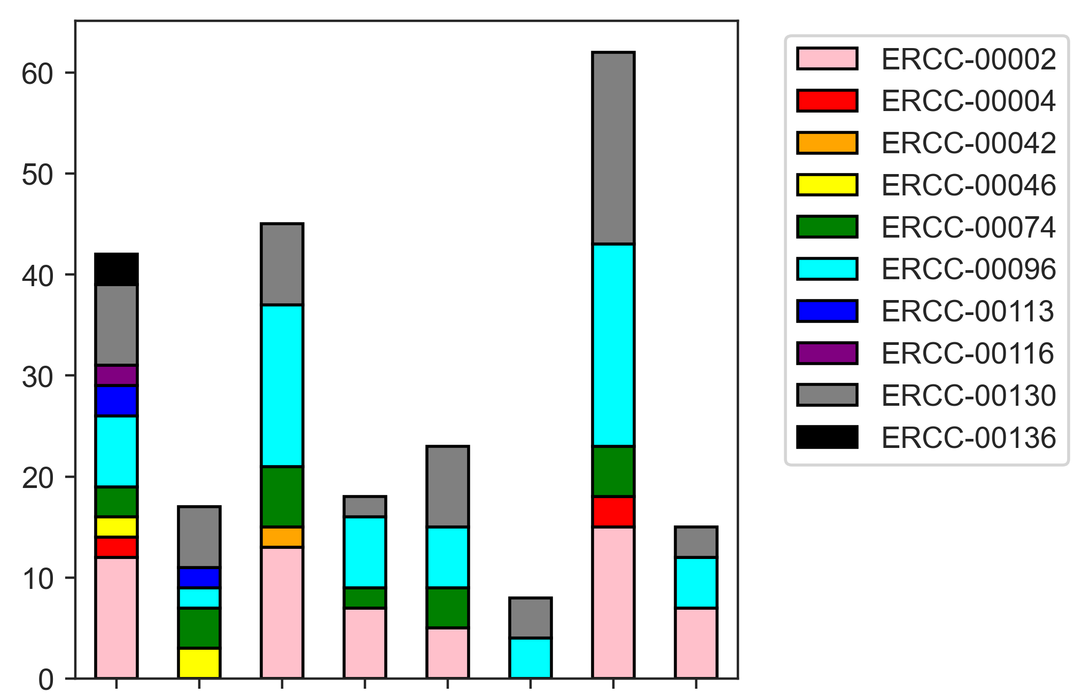
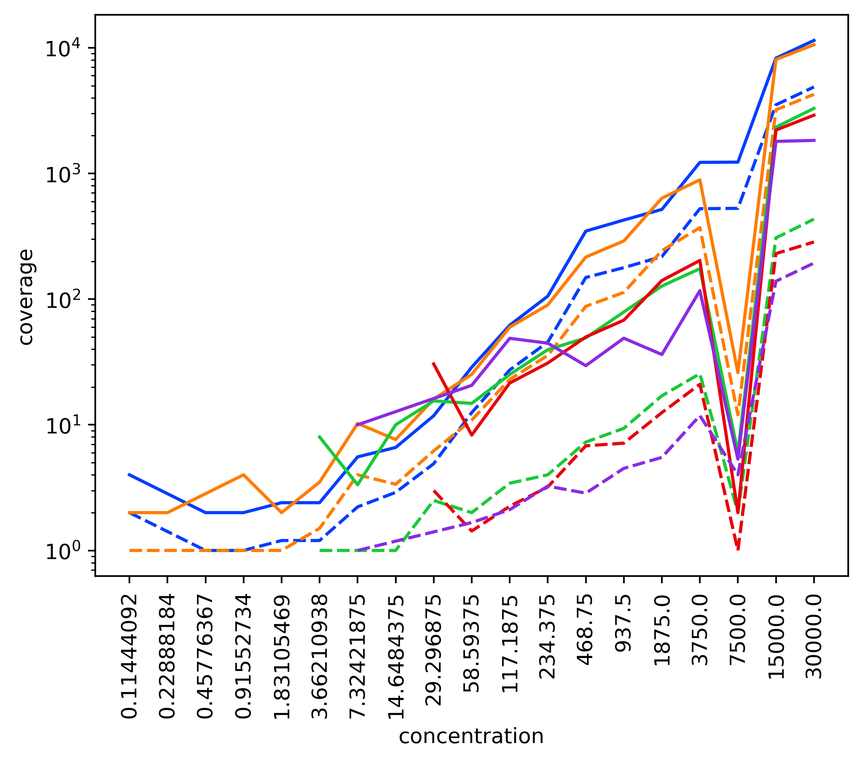
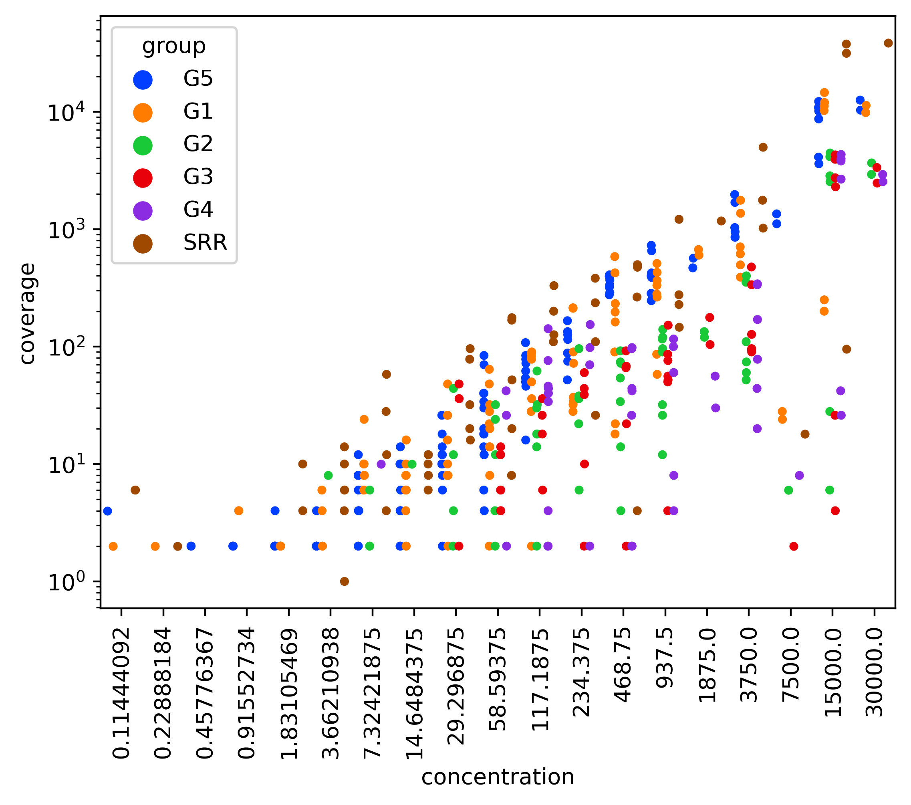
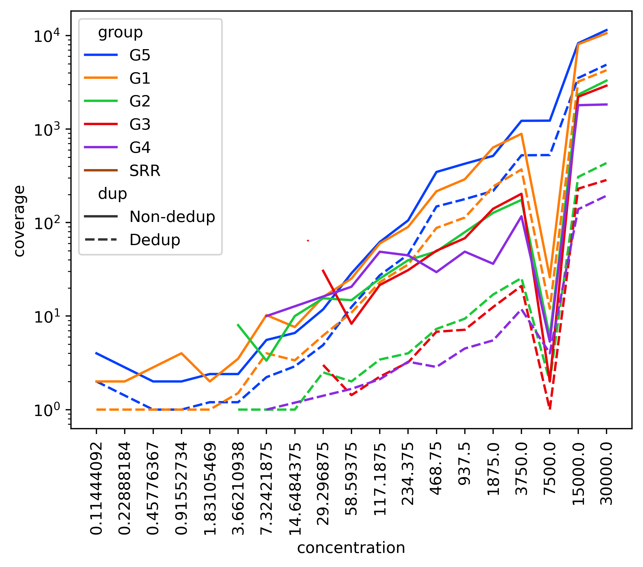
A
ERCC reads containing > 20 Cs
MT-A
MT-B
MT-C
MT-D
B
10⁴
10³
10²
10¹
10⁰
RNAseq
MT-A
MT-B
MT-C
MT-D
ERCC read coverage
Non-dedup
Dedup
Concentration (attomoles/ul)
Supplementary Figure 4. (A) ERCC coverage of reads containing more than 20 p-m⁵C artifacts (minimum 2 reads). (B) ERCC coverage compared to input ERCC concentration in non-UMI-deduplicated libraries and their corresponding deduplicated libraries. Reads were mapped using meRanGh. Concentrations were prepared according to the ThermoFisher protocol (Methods). Each concentration listed contains multiple unique ERCCs.

